Slide 1
OPIM 5604
Predictive Modeling
Linear Regression
Jennifer Eigo, Instructor in-Residence

Slide 2
Topics
Linear function
Small example by hand
Fitting a full predictive model
Assessing predictive accuracy
Selecting a subset of predictors

Slide 3
Predictive Modeling
Goal: predict target values in other data where we have predictor values, but not target values
Classic data mining context
Model Goal: Optimize predictive accuracy
Train model on training data
Assess performance on validation and test data
Gain insight into role of predictors

Slide 4
Linear Function
p = number of
predictors
Standard linear function:
Coefficients are estimated using Ordinary Least Squares (OLS) to minimize the sum of the squared deviations between actual and predicted values
Assumptions (not very strict):
  Variables have a linear relationship to target
  Cases are independent of each other
  Error is similar and random in all ranges of data

Slide 5
Example: Prices of Toyota Corolla
Goal: predict prices of used Toyota Corollas based on their specification
Data: Prices of 1000 used Toyota Corollas, with their specification information
First we will focus on Mileage, then expand to consider all variables.

Slide 6

Small Example – One predictor
Predict the price of a Toyota Corolla using Mileage
We can use that formula like this:
Price = Intercept + Slope * Mileage
For every mileage in our dataset, we want to pick the slope and intercept that makes the predicted price as close to the actual price as possible.

Slide 7
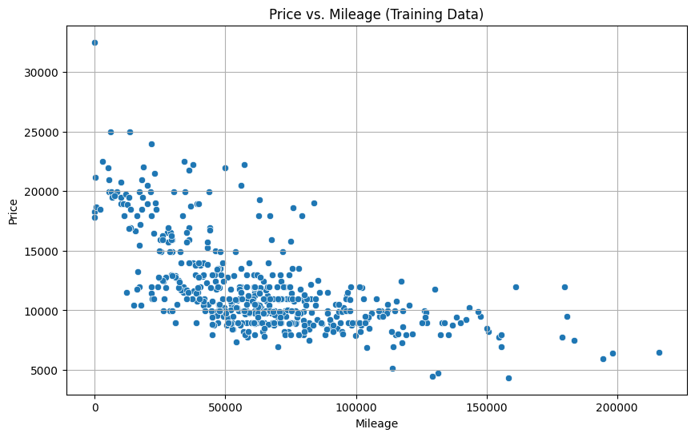
Small Example – Exploring Mileage

Slide 8
Small Example – Fit Model
Can we fit a line through the training data to make a best prediction of price?
Calculate the slope:
m = sum((x_{i} - mean_x) * (y_{i} - mean_y)) / sum((x_{i} - mean_x)^2)
Calculate the intercept:
b = mean_y - m * mean_x

Slide 9
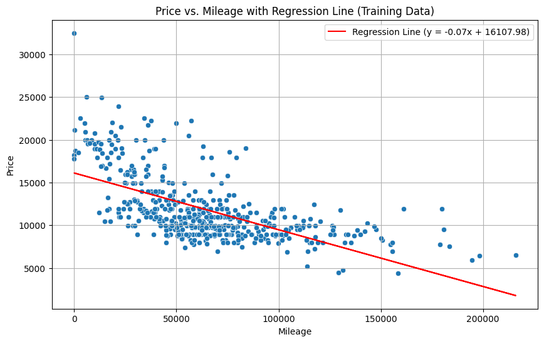
Small Example – Fit Model

Slide 10
Multiple Linear Regression

Slide 11
Multiple Linear Regression
Partition the data
Define the target variable (y)
Define the predictor variables (x)
Fit the model
Evaluate model performance on each partition
Visualize the results

Slide 12
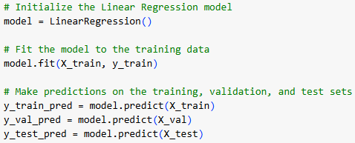
Fit the Model
Fit the model in three steps
  Define the model that we are using
  Calculate the best intercept and coefficients to create the regression formula
  Apply the formula to each row to solve for the target

Slide 13
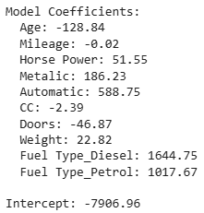
Interpret the Coefficients
The regression formula is formed by the coefficients
Positive values increase Price
Negative values decrease Price
Categorical coefficients
compare to the reference level
which is the value dropped
when dummy variables are
formed, which in this case
is CNG for Fuel Type

Slide 14

Check Performance
Model performance is measured by RMSE and R Squared
  Lower RMSE is better
  Higher R Squared is better
Performance is reported for each partition separately to check for overfitting

Slide 15
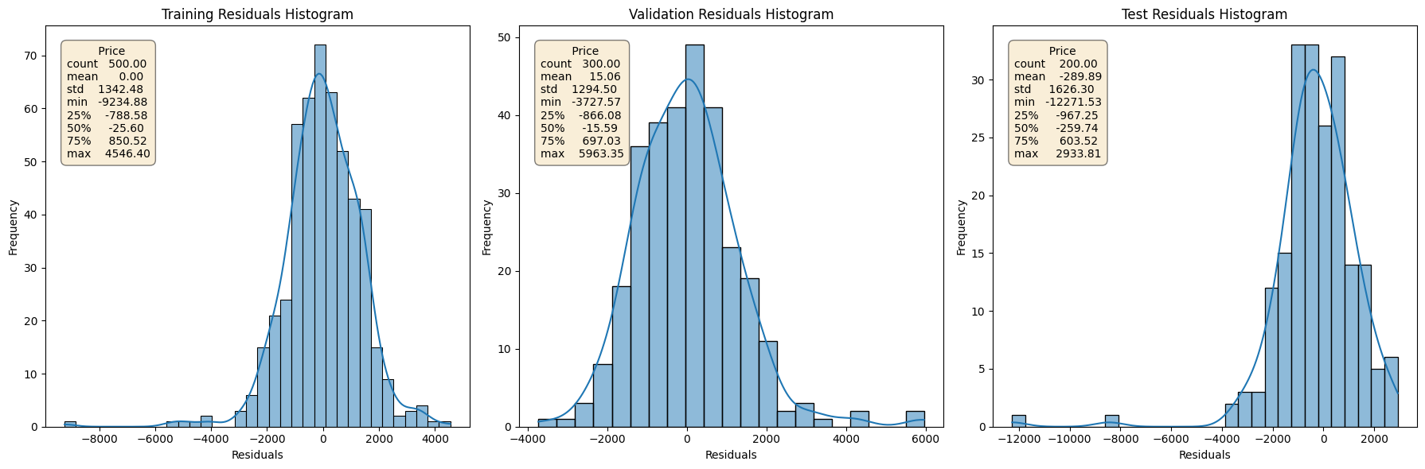
Visualize the Results
Visualize the distribution of residuals to see row level errors

Slide 16
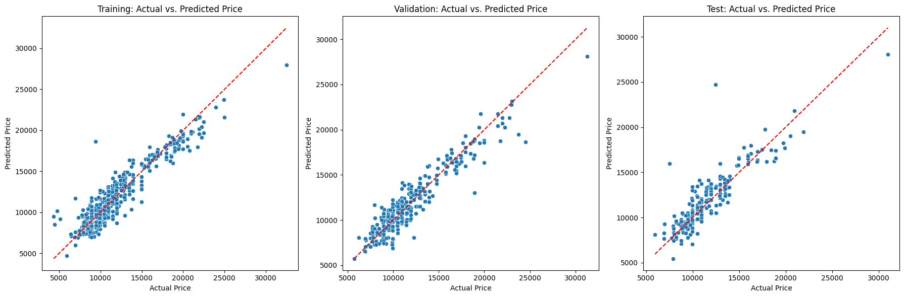
Visualize the Results
Visualize the actual by predicted plots to see row level errors

Slide 17
Variable Selection

Slide 18
Selecting Subsets of Predictors
Goal: Find a parsimonious model (the simplest model that performs sufficiently well)
  More robust
  Higher predictive accuracy
Manual Approach
  Evaluate P values to identify important variables
Popular Subset Selection Algorithms
  Forward selection
  Backward elimination
  Mixed Stepwise

Slide 19
P-Value Review
P-Value is the probability that the Null Hypothesis is true.
When considering predictor variables:
Null Hypothesis
  The coefficient for the variable = 0
  The variable is not significant; it has no impact on the target
Alternate Hypothesis
  The coefficient is <> 0
  The variable is significant; it does impact the target
Alpha is the threshold for determining significance
  Often 0.05 but depends on business case!

Slide 20
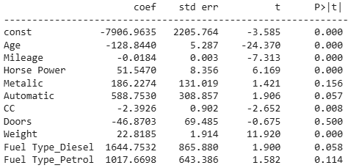
Check for Variable Significance
P values measure statistical significance of each predictor
Tiny P values (below 0.05) are the best!

Slide 21
Backward Elimination
Start with all predictors
Successively eliminate least useful predictors one by one
Stopping Rules
  P-value Threshold: Stop when all remaining predictors have statistically significant contribution
  Max Validation RSquare: Stop when the RSquare on the validation set stops improving when predictors are removed

Slide 22
Forward Selection
Start with no predictors
Add them one by one (add the one with largest contribution)
When to stop:
  P-value Threshold: Stop when no other potential predictor has statistically significant contribution
  Max Validation RSquare: Stop when the RSquare on the validation set stops improving when predictors are added

Slide 23
Mixed Stepwise
Like Forward Selection
Except at each step, also consider dropping non-significant predictors
Stopping Rules
    P-value Threshold: Stop removing when all remaining predictors are significant, and stop adding when no other potential predictor is significant

Slide 24
Summary
Linear regression models are very popular, not only for explanatory modeling, but also for prediction
A good predictive model has high predictive accuracy
Regression models are built using a training data set, and evaluated on a separate validation (and sometimes test) data set
Removing redundant predictors is key to achieving predictive accuracy and robustness
Subset selection methods help find “good” candidate models. These should then be run and assessed.

